Slide 1
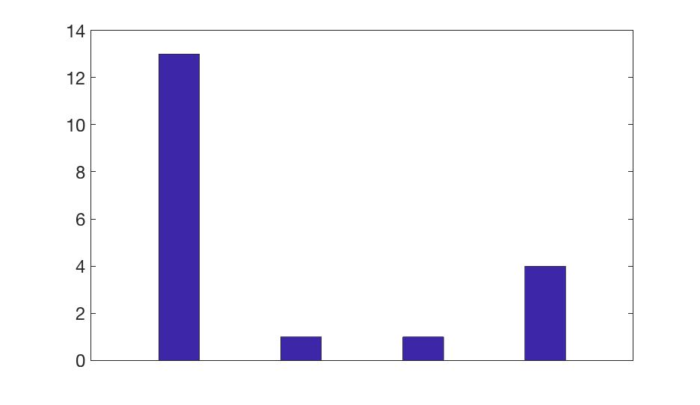
Nr of participants
Collected:
0 1 2 3

Slide 2
Paths in Matlab:
In matlab it is often important to know about/define paths. Paths are simply where a certain piece of information (e.g. script or data) is located. In matlab paths are often just simple strings (e.g. C:/Data/AdvancedPractical/ )
Load or use things in Matlab:
In order to load data or run scripts you need to know where they are i.e. know the path. Otherwise matlab has only access to its overall library (i.e. known scripts) and the folder it is currently in. If you don’t know where matlab currently is, just check on top of your command console
Define things in Matlab:
Generally speaking, in matlab whatever is written on the left of an equation is something you are declaring or defining. Make sure to use sensible names so that your code remains readible to other and yourself months later
Data Management/Hierarchies:
Slightly more advanced but eternally useful is knowing about good data organization. It matlab it is possible to organize your data in hierarchies (often in form of structures).

Slide 3
How to navigate in matlab:
useful commands here are
ls: show contents of your current working directory
pwd: show your current/present working directory
cd: change your current working directory. Either the complete path or relative to where you are
Debugging in matlab:
keyboard: only write this in the script. The script will stop where this is written and keep all information in its working memory, for you to have access for debugging
dbstop if error: Gives you the debug mode like keyboard, whenever there is an error in your code.
dbcont: continues code from where it stopped.
dbup: goes up a function
dbdown: goes down a function

Slide 4
The why of exploring you model!

Slide 5
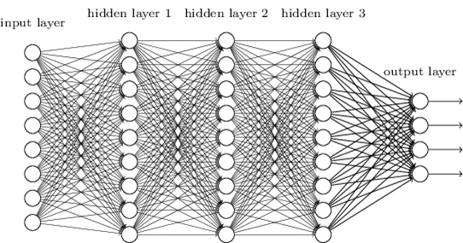
The why of exploring you model!
A model might be too complex for you to predict the effects of changes a specific feature (see complex systems)
Building models forces one to specify everything
You can try out different solutions to a problem to see how they work
You can optimize your observations to discriminate between models and hypotheses
Its great fun!

Slide 7
Example schedule and choices

Slide 8
Work through Handout until ‘creating simulations from the Model’
Line 133: utility1= ; % Tip: use magOpt1 probOpt1
Line 134: utility2= ; % Tip: use magOpt1 probOpt1
Line 141: DecisionVariable=; % Tip: use utility1 and utility2

Slide 9
Simulating agents

Slide 10
Behaviour during schedule

Slide 11
How to analyse your (real) data?
2) Use a computational model
Parse a single behaviour (button press) into underlying components
E.g. reinforcement learning model; components:
A) Learn the prediction (outcome yes/no):
New Prediction = Old Prediction + LearningRate x PredictionError
High learning rate
Low learning rate

Slide 12
How to analyse your (real) data?
2) Use a computational model
Parse a single behaviour (button press) into underlying components
E.g. reinforcement learning model; components:
B) Combine the prediction with the magnitudes:
Utility = Prediction *Magnitude

Slide 13
How to analyse your (real) data?
2) Use a computational model
Parse a single behaviour (button press) into underlying components
E.g. reinforcement learning model; components:
C) Make choice probability

Slide 14
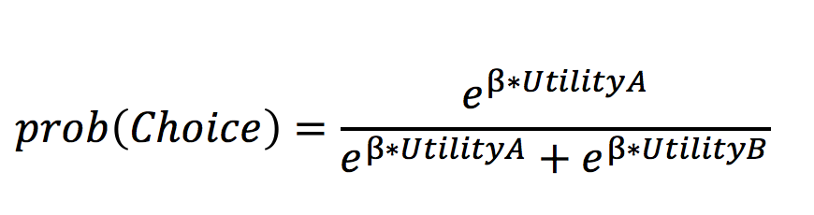
How to analyse your (real) data?
2) Use a computational model
Parse a single behaviour (button press) into underlying components
E.g. reinforcement learning model; components:
A) Learn the prediction (outcome yes/no):
B) Combine the prediction with the magnitudes:
C) Make choice probability
[Simulation only: D) Translate probability into an actual choice]
New Prediction = Old Prediction + LearningRate x PredictionError
Utility = Prediction *Magnitude

Slide 15
Work through Handout until ‘The Importance of playing around with a model’

Slide 16
What is a free parameter in a model?
Any suggestions?
A free parameter is a parameter in a model that is ‘free’ i.e. take on any value but often within a confined range of possibilities (e.g. learning rates vary between 0 and 1).
Because they are free they need to be fit to the data.

Slide 17
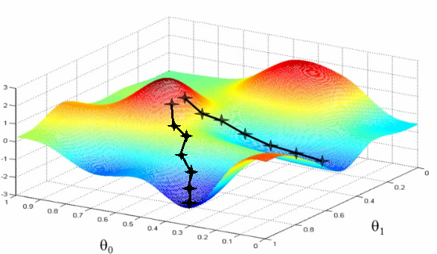
Model Fitting Procedure (fminsearch)
Minimizing negative log likelihood, i.e. finding the model with the highest probability given the data [p(Data|Model)]
Negative log likelihood (badness of fit)
Parameter one (e.g. alpha)
Parameter two (e.g. inverse T)

Slide 18
Block 1 - stable
Block 2 - volatile
Reason for designing the experiment (Hypothesis):
Are people sensitive to how stable the environment is (->Bayesian)

Slide 19
How to analyse your (real) data?
Bin your data
(i.e. split according to some criterion)
What is the problem?
Averages ignore features or actual interest
More sensitive averages: not many trials left to average over

Slide 20
How do you know your modelling is valid?
Know the ‘ground truth’: can check whether your task and analysis work:

Slide 21
Simulating agents
One alpha
Two alphas

Slide 22
Parameter Recovery using simulations
One alpha agent
Simulation
Outcome
Sequence
α
Softmax
Choice
Sequence
Recovered/Fit
Parameter estimates
α₁
α₂
Softmax

Slide 23
Parameter Recovery using simulations
Two alpha agent
Simulation
α₁
Outcome
Sequence
Softmax
Choice
Sequence
α₂
Recovered/Fit
Parameter estimates
α₁
α₂
Softmax

Slide 24
Why is Parameter recovery important?
Two alphas One alpha

Slide 25
Work through Handout until ‘optional regression analysis’

Slide 27
Multiple regression analysis
Y≈β₀ + β₁*Reggressor₁ + β₂*Reggressor₁ + β₃*Reggressor₁ + β₄*Reggressor₁

Slide 28

Multiple Regression

